Slide 1
LAMBDA FUNCTIONS

Slide 2
What is it?!
What is a lambda function | Limitations:
Lambdas are pythons way of creating anonymous functions. They are functions without a name, simple and short lived so worth writing the function in one line. | Lambdas cannot have default parameters Can’t contain complex logic

Slide 3
Syntax Let’s put it down simply:
f = lambda x , y : x + y
Everything after the colon is what should be done with the parameters
The word lambda says this is an anonymous function
Everything before the colon are the parameters

Slide 4
Regular Function Vs. Lambda Function
regular function
def sum_nums(x,y):
f = x+y
return f
lambda function
lambda x,y: x + y

Slide 5
Pros and Cons
Pros | Cons
Good for simple logical operations that are easy to understand. This makes the code more readable too. Good when you want a function that you will use just one time. | They can only perform one expression. It’s not possible to have multiple independent operations in one lambda function. Bad for operations that would span more than one line in a normal def function (For example nested conditional operations).

Slide 6
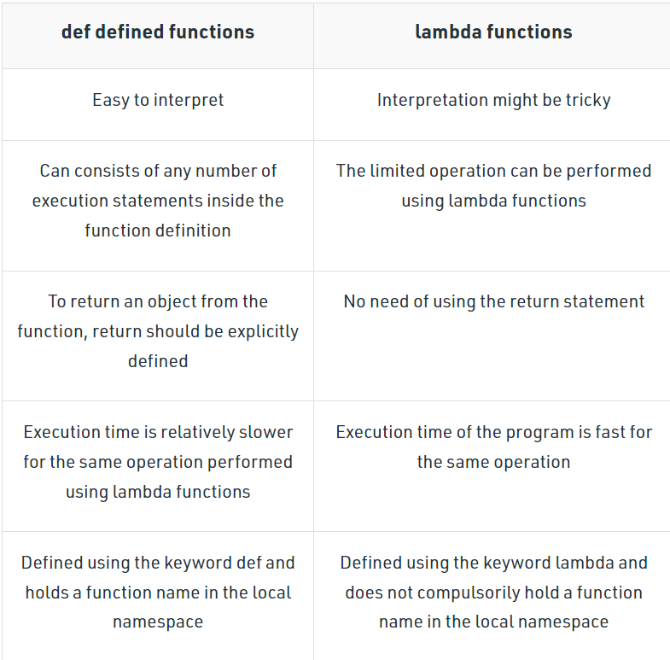
Table of Differences

Slide 7
Deep Note Level One Class Work

Slide 8
CONDITIONAL STATEMENTS
Scalar values – Lists – Series - Dataframes

Slide 9
Using if-else in lambda function
When using lambda with if-else conditions in Python, here is the following general syntax:
lambda <arguments> : <statement1> if <condition> else <statement2>
Here, the lambda function will return statement1 when if the condition is true and return statement2 when if the condition is false
Example:
conditional = lambda a: a/10 if a < 20 else a

Slide 10
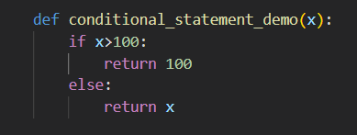

Def Vs. Lambda (if-else)

Slide 11
Using if else & elif in lambda function
We can also use nested if, if-else in lambda function. Here is the following general syntax:
lambda <arguments> : <statement1> if <condition > ( <statement2> if <condition> else <statement3>)
Here, statement1 will be returned when if the condition is true, statement2 will be returned when elif true, and statement3 will be returned when else is executed.
Example:
conditional = lambda a: a/10 if a < 20 else a

Slide 12
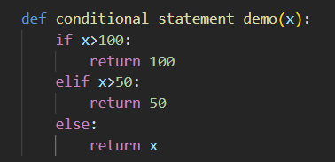

Def Vs. Lambda (if-else-elif)

